Slide 1


Capstone project tableau
By Ragul

Slide 2



Introduction
The goal of this analysis is to explore a dataset containing information on bank customers and their payment behavior, and to use data visualization techniques in Tableau to gain insights into the factors that contribute to attrition from bank.
In this analysis , we will use Python libraries such as Pandas to explore the dataset, perform data cleaning and preprocessing, and create visualizations by using tableau to analyze the data.

Slide 3
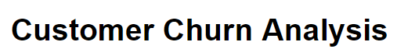
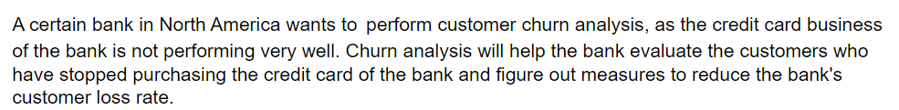



Slide 4
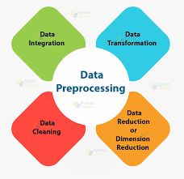
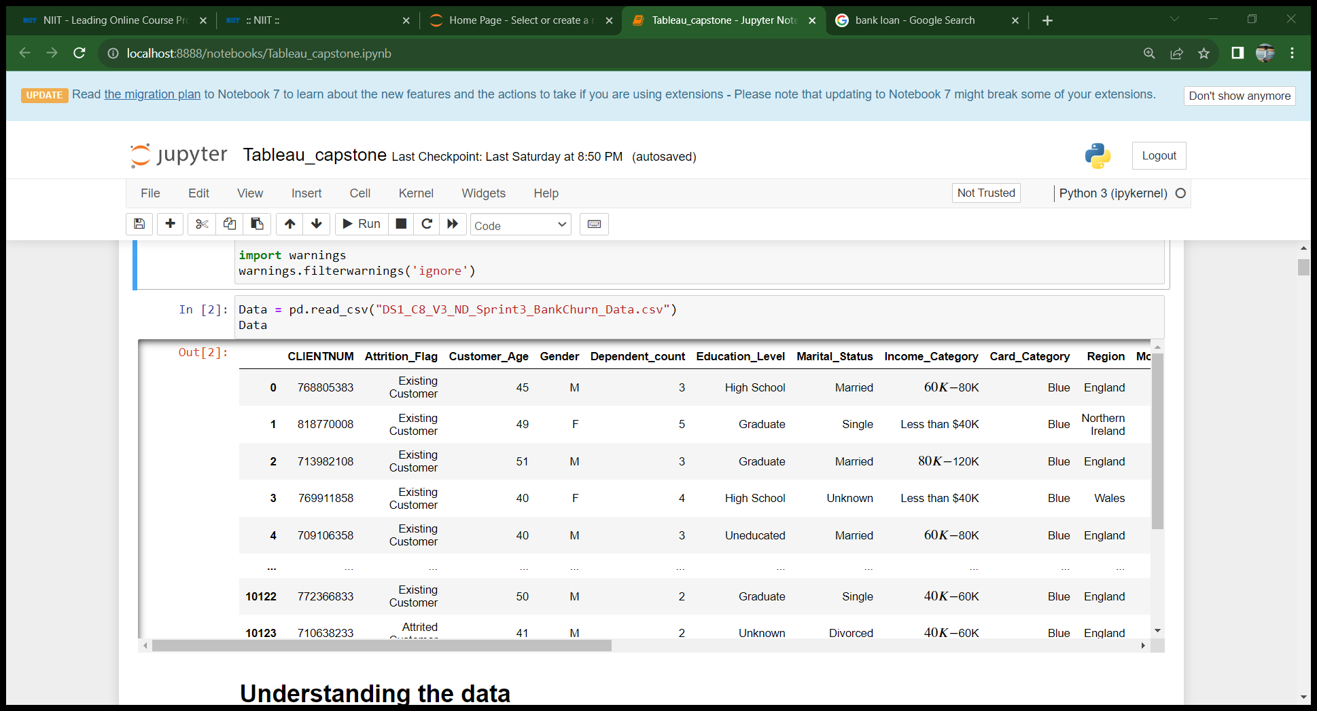
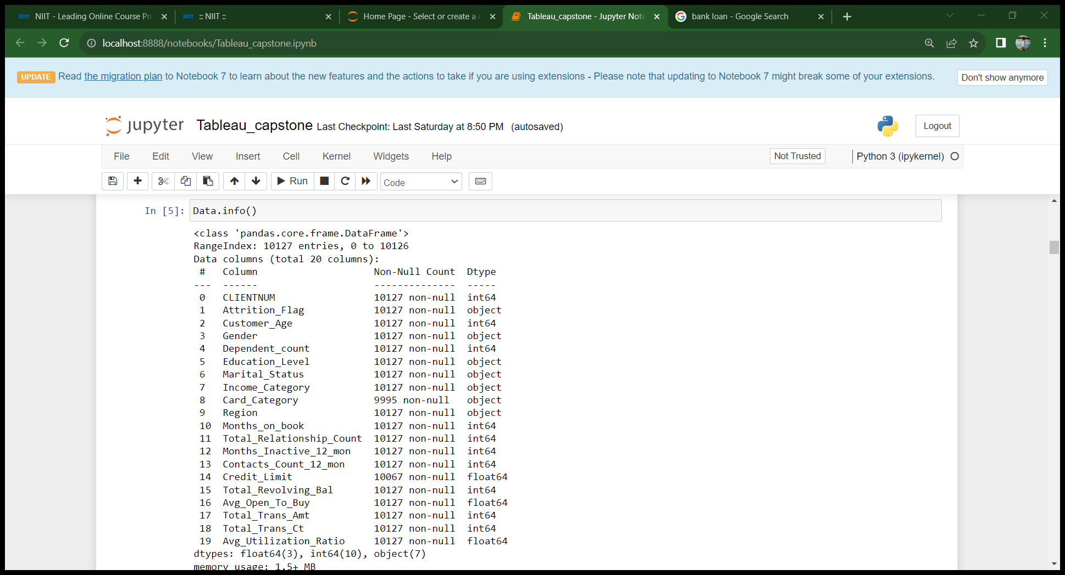
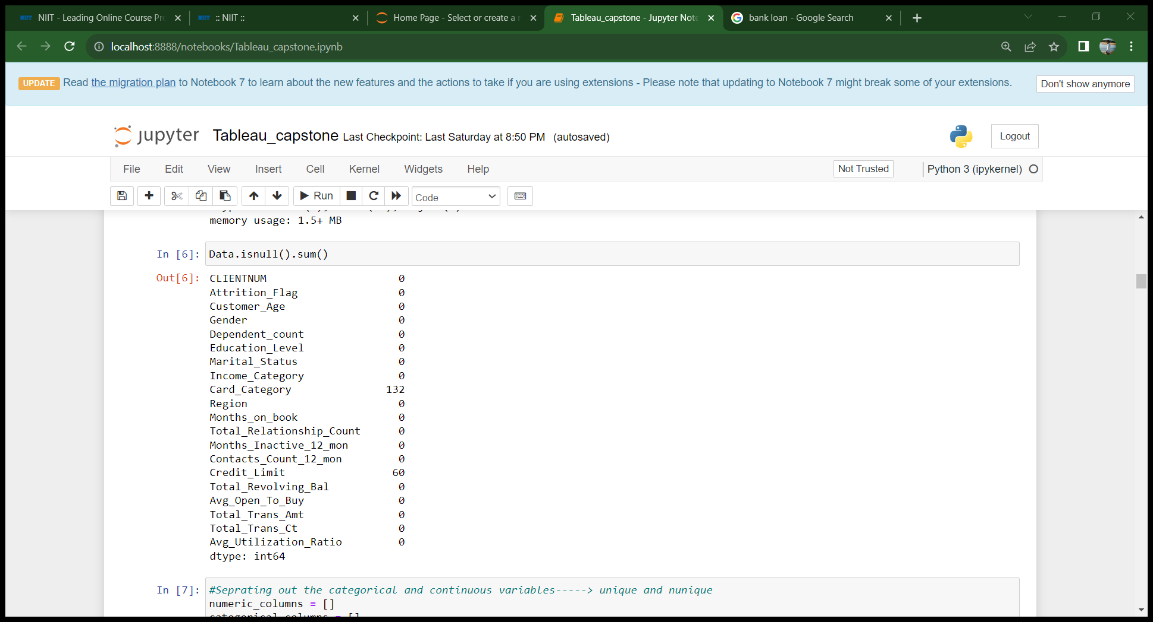
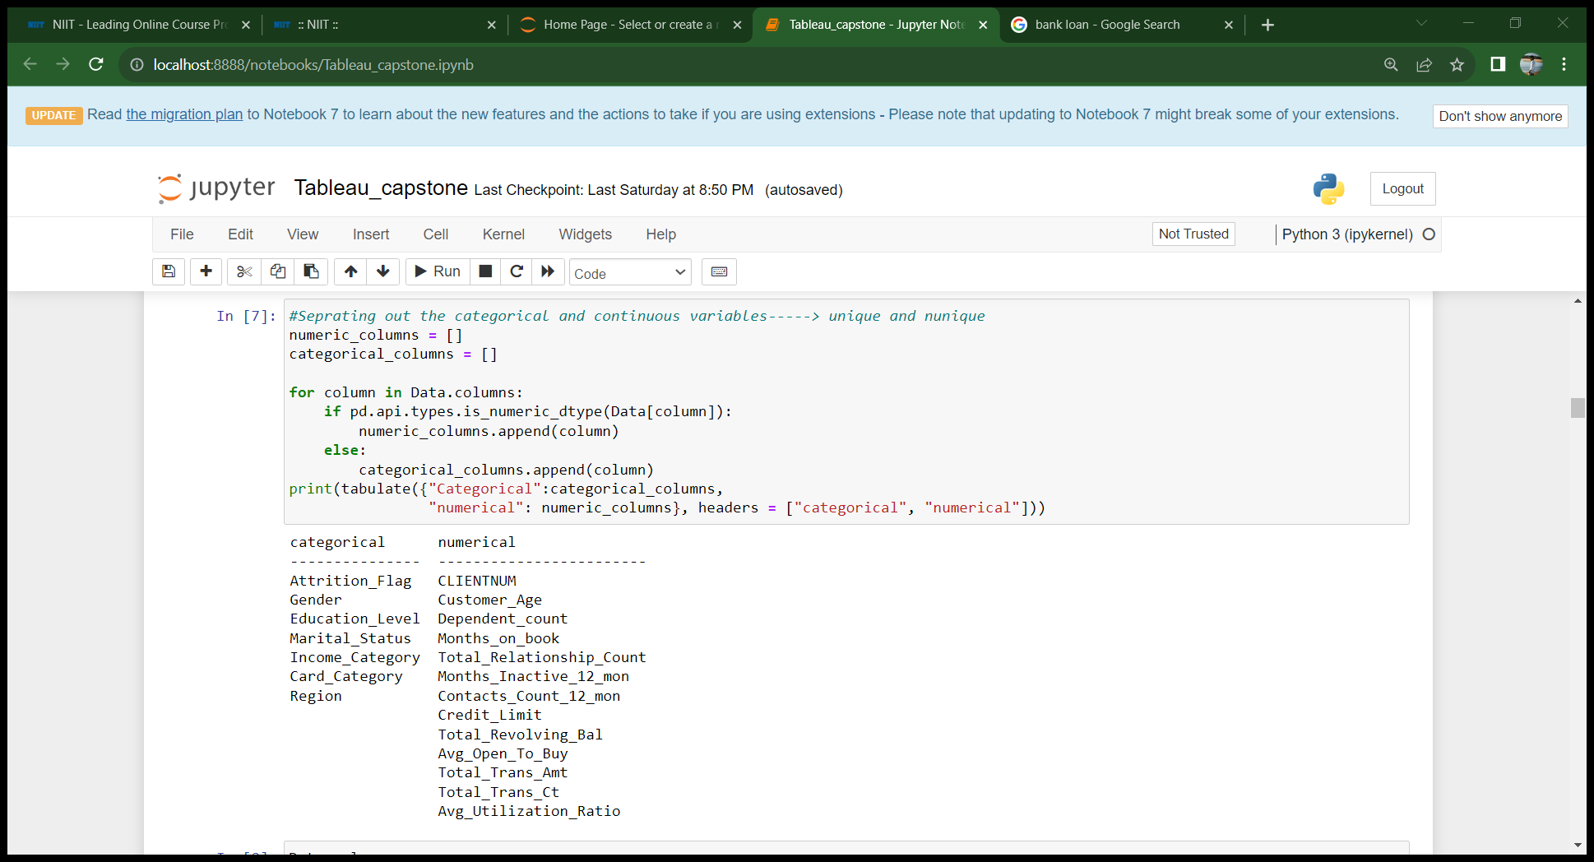
Data Pre-processing using Python
Seperated categorical and numerical columns

Slide 5

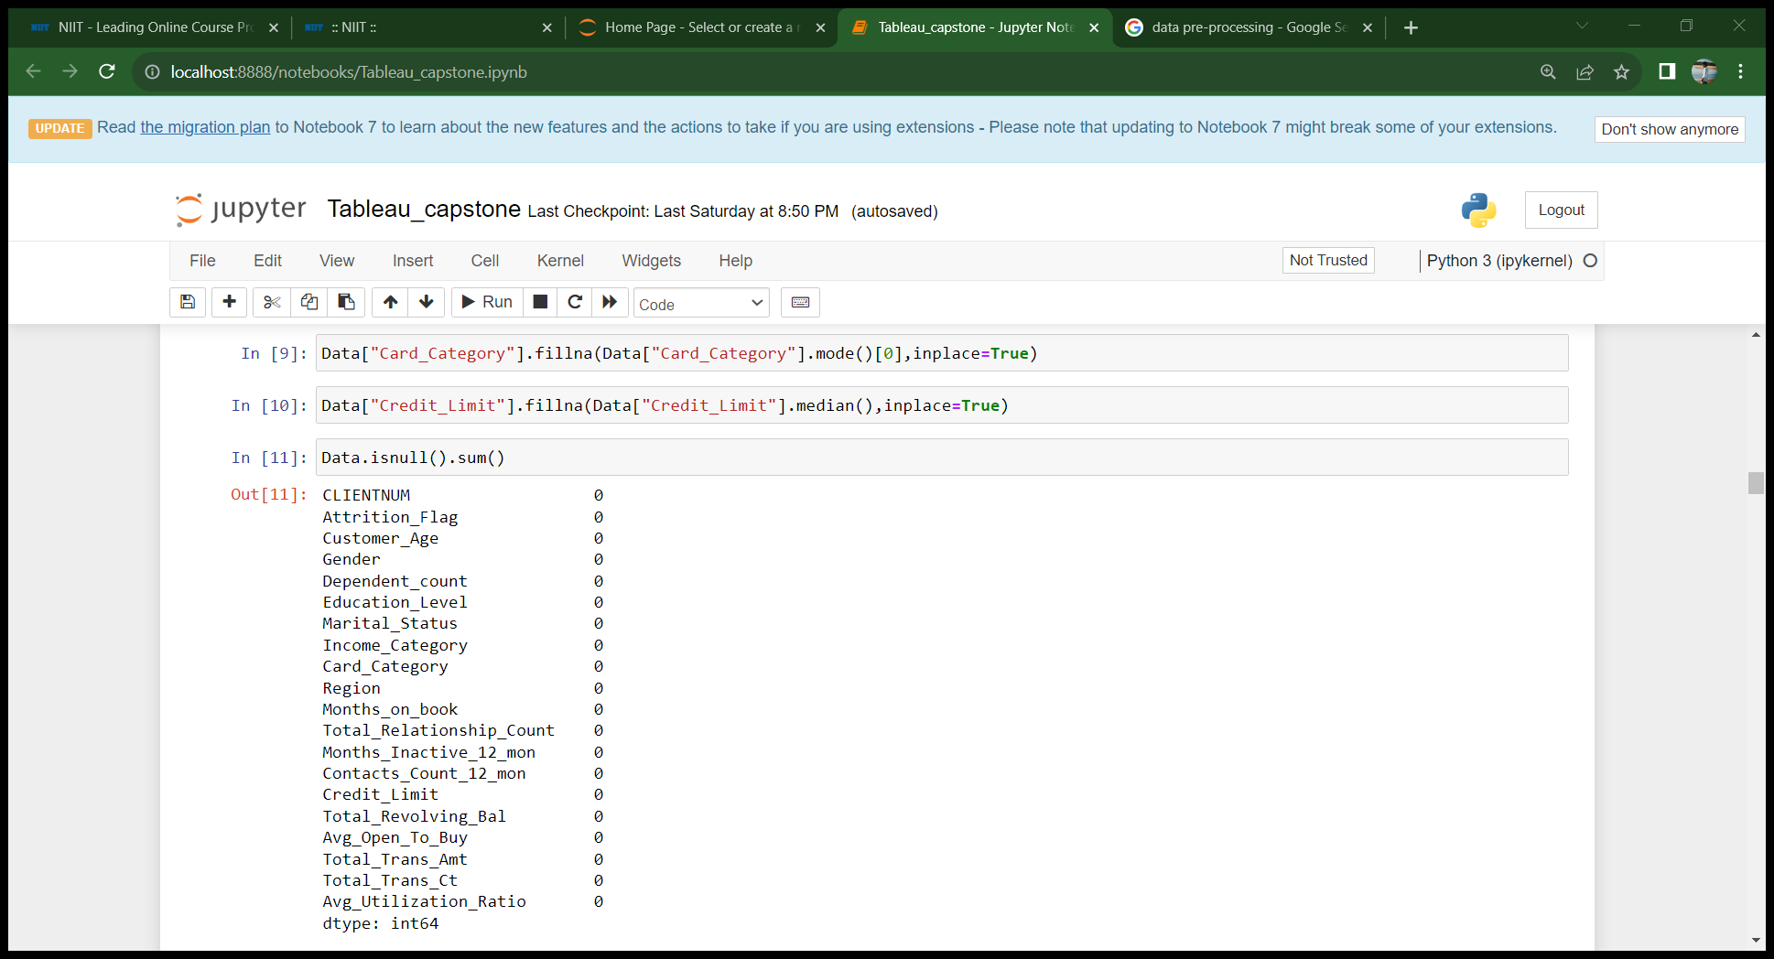
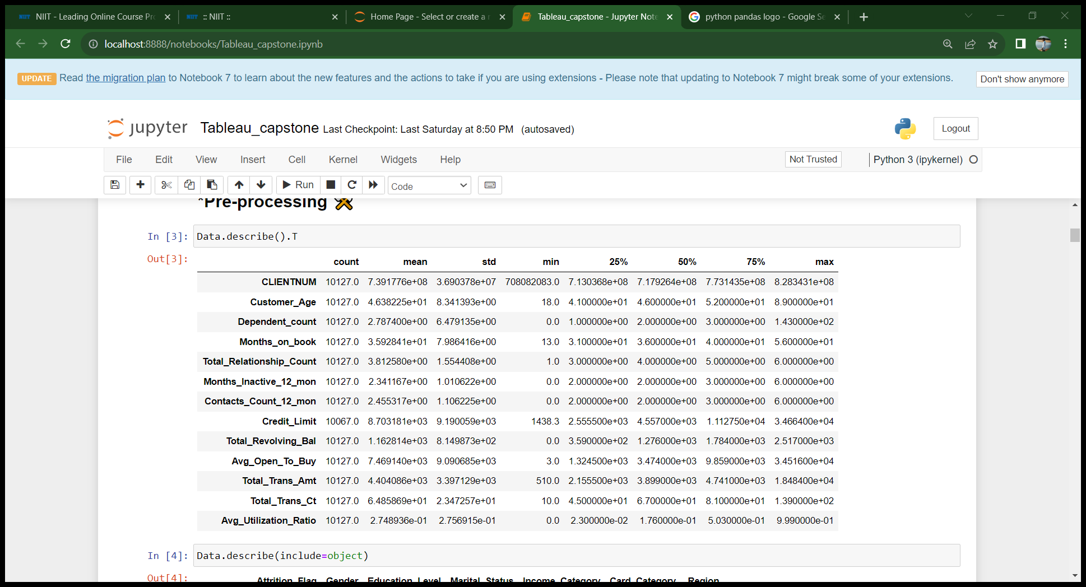
Null value treatment
50% of the customers age is in between 41 to 52.
Maximum dependent count is 143,which is not valid
Credit limit, avg open to buy , total trans amt has high standard deviation so data of these features are widely distributed and high skewed.

Slide 6

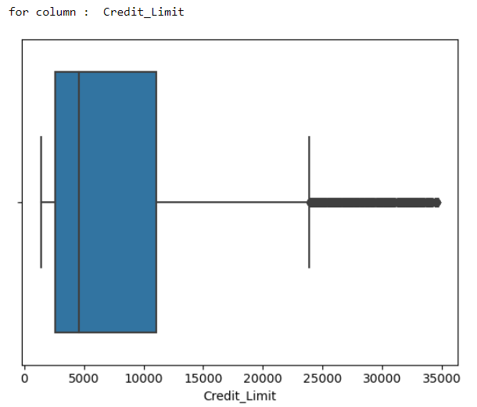
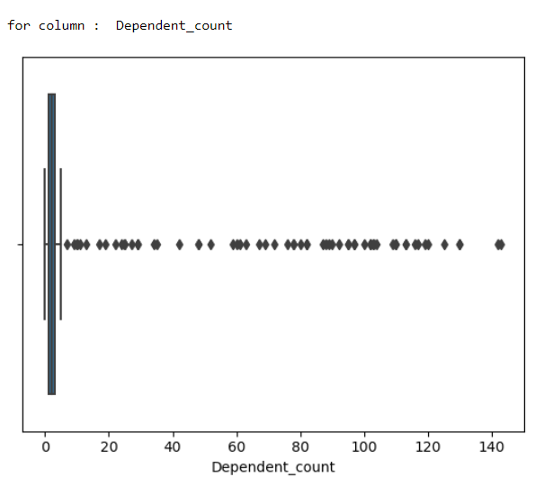
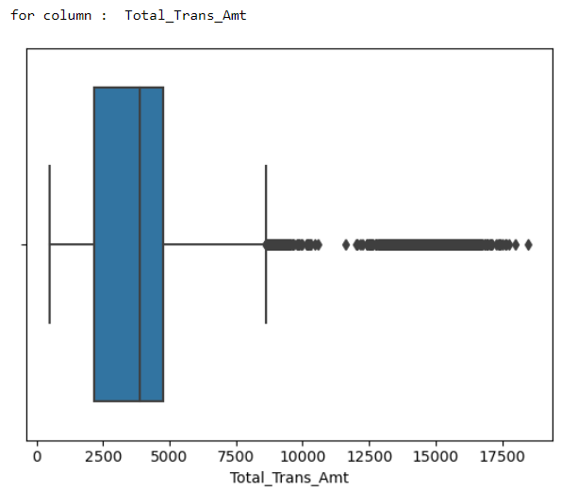
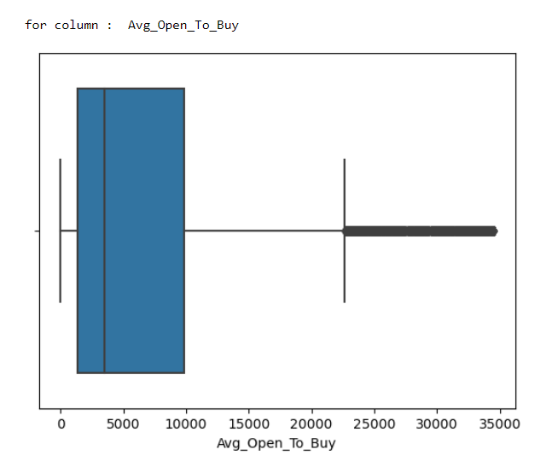
Outliers analysis

Slide 7
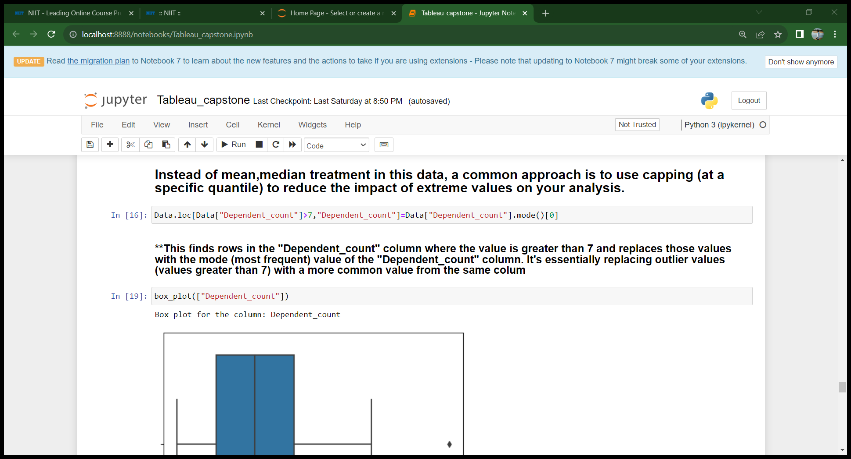
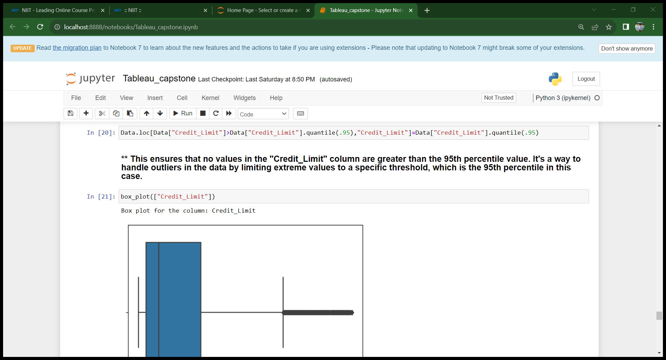
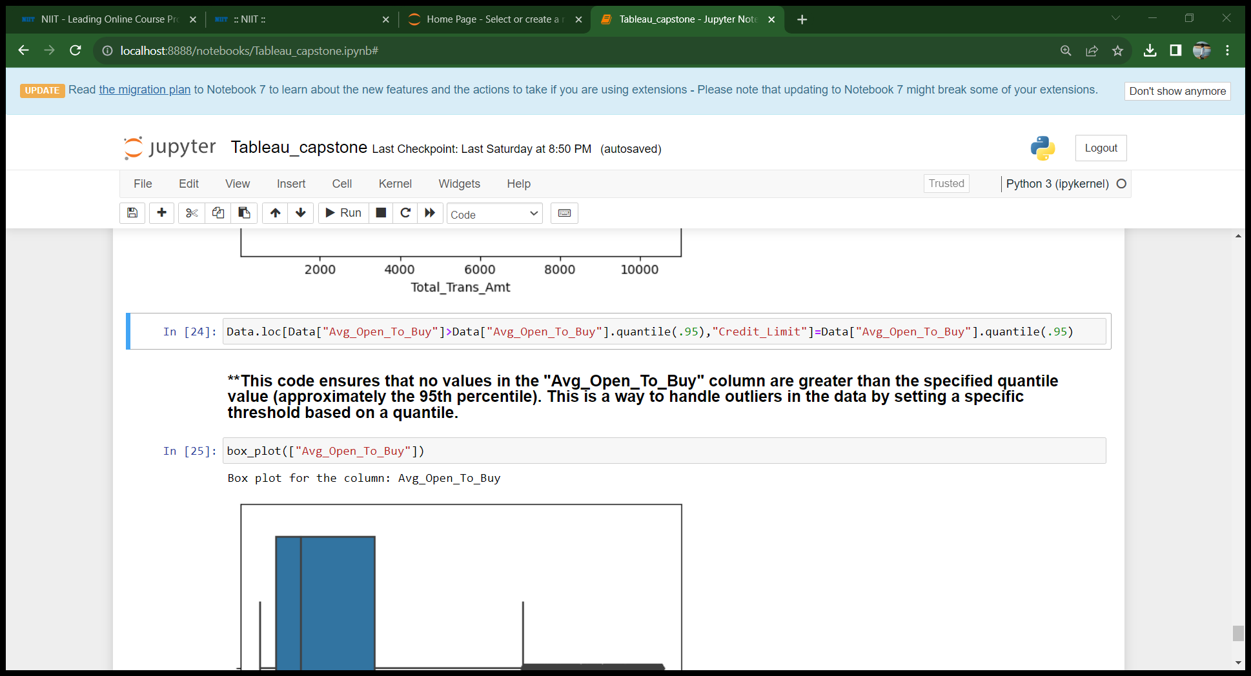
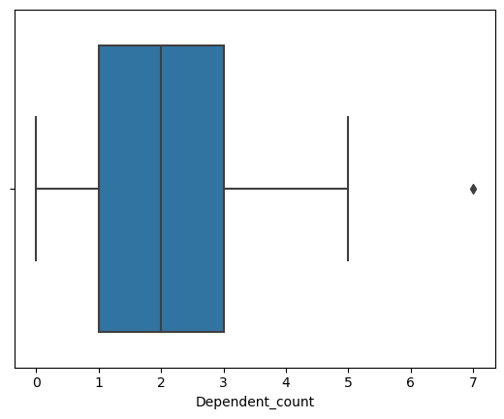
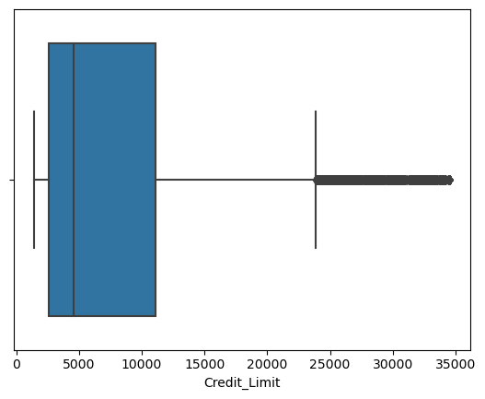
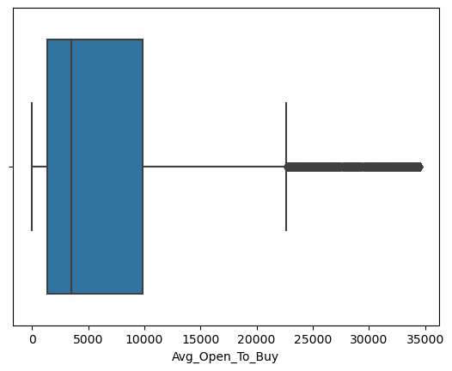
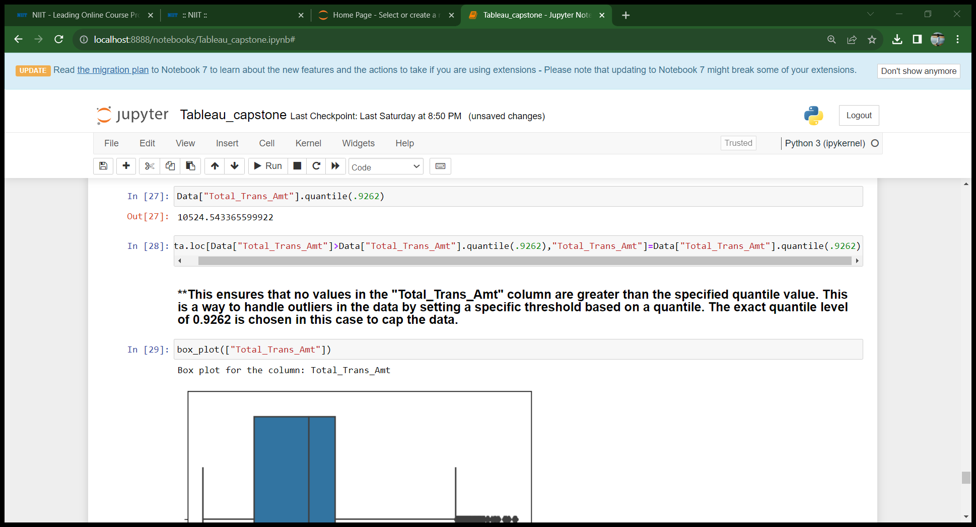
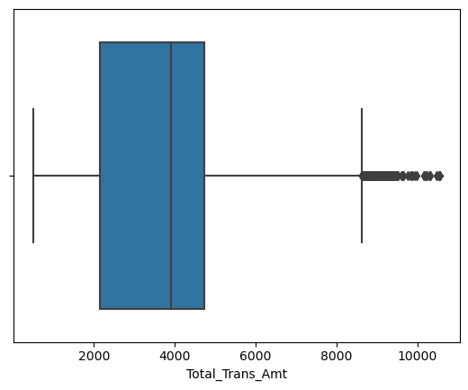
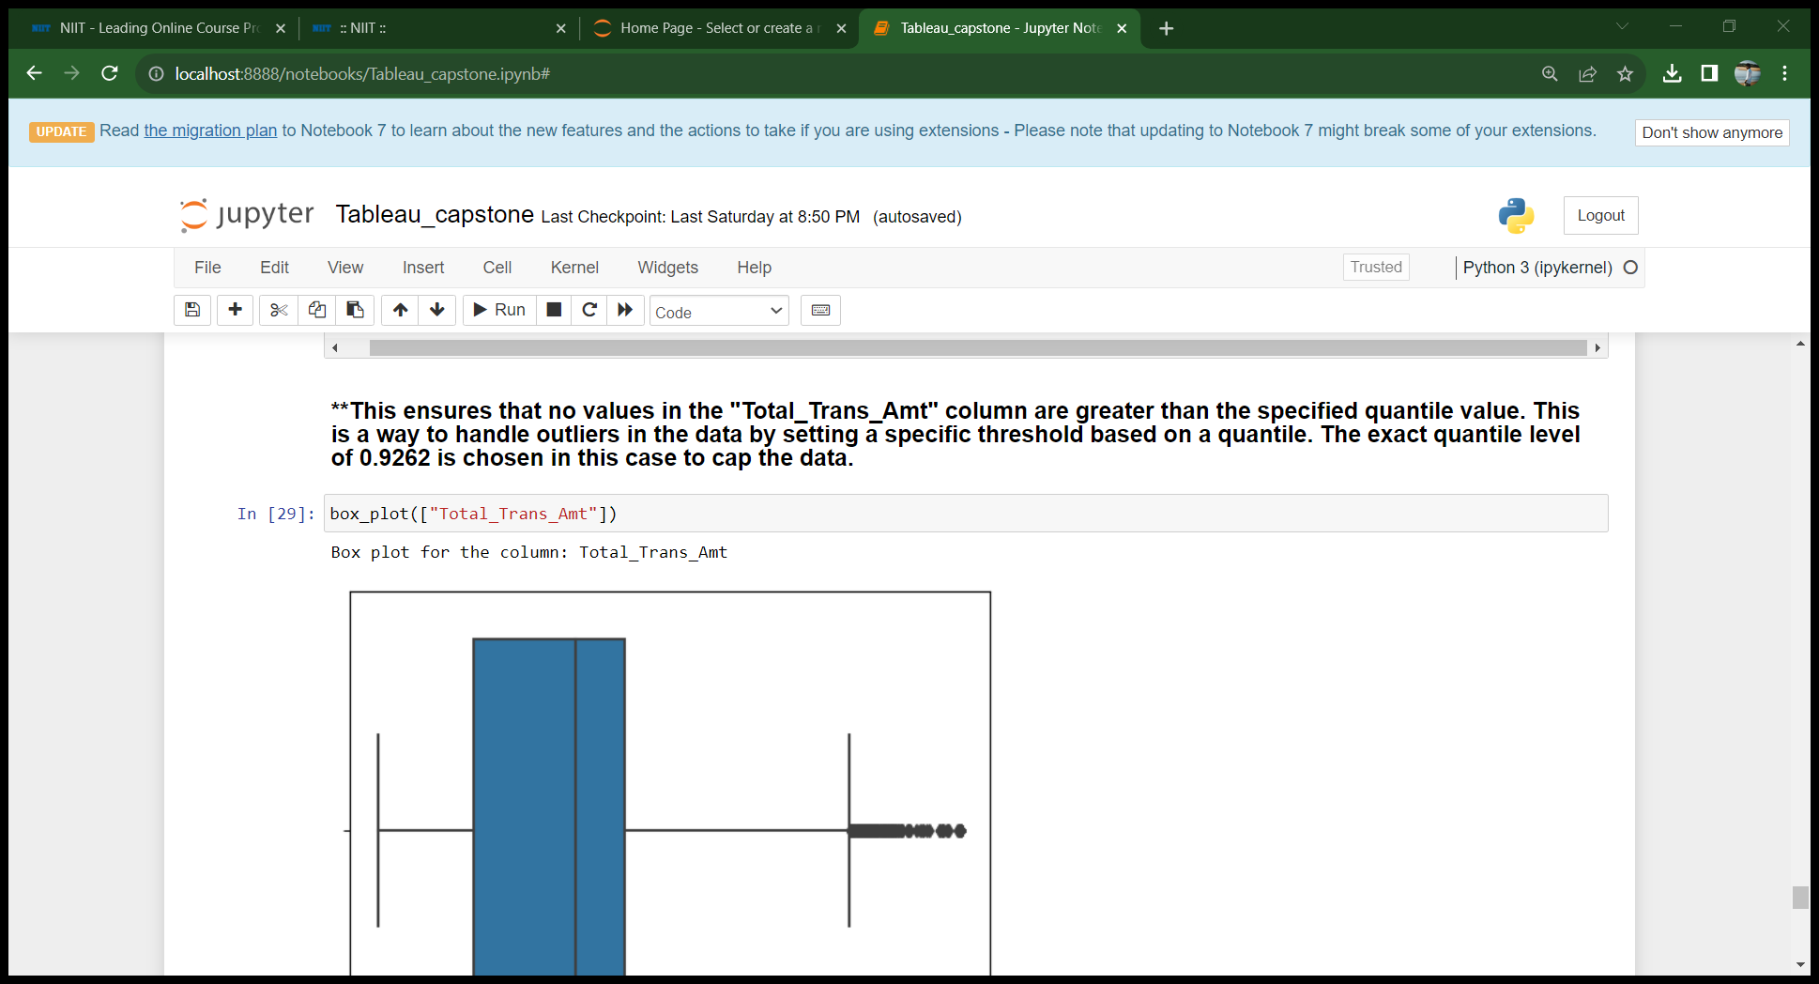
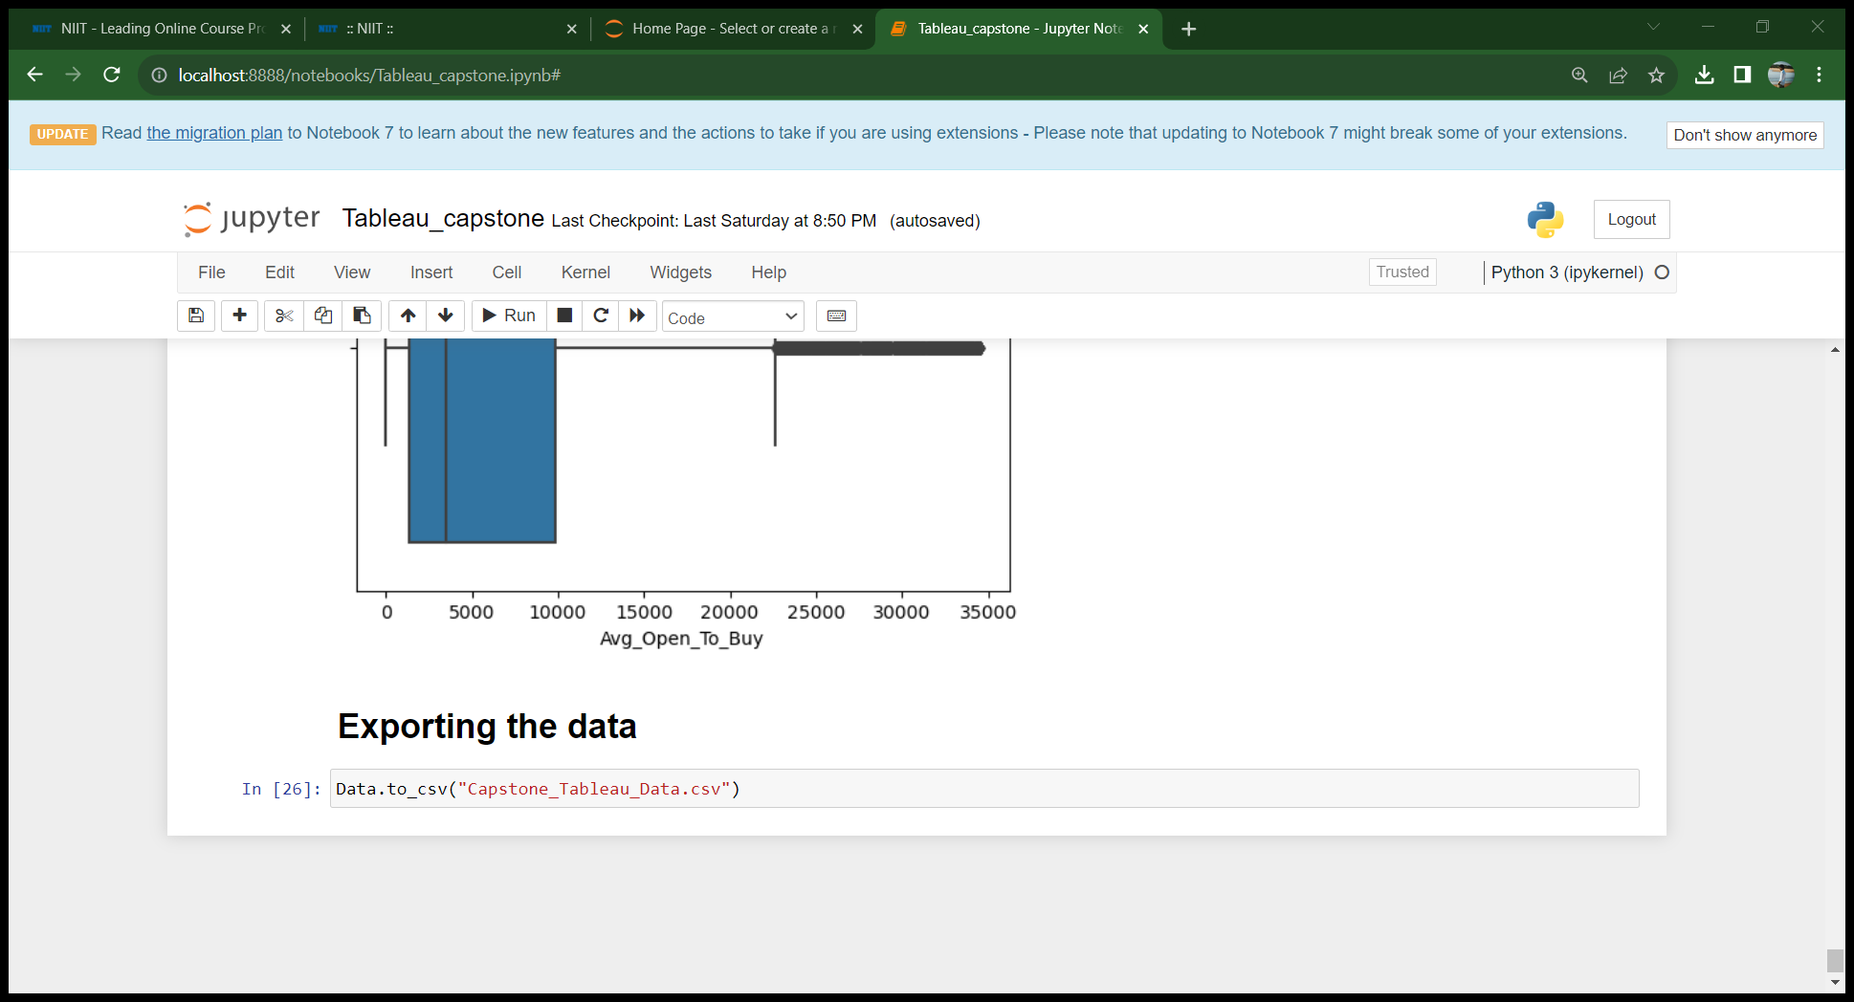
Outliers treatment
Exporting data

Slide 8
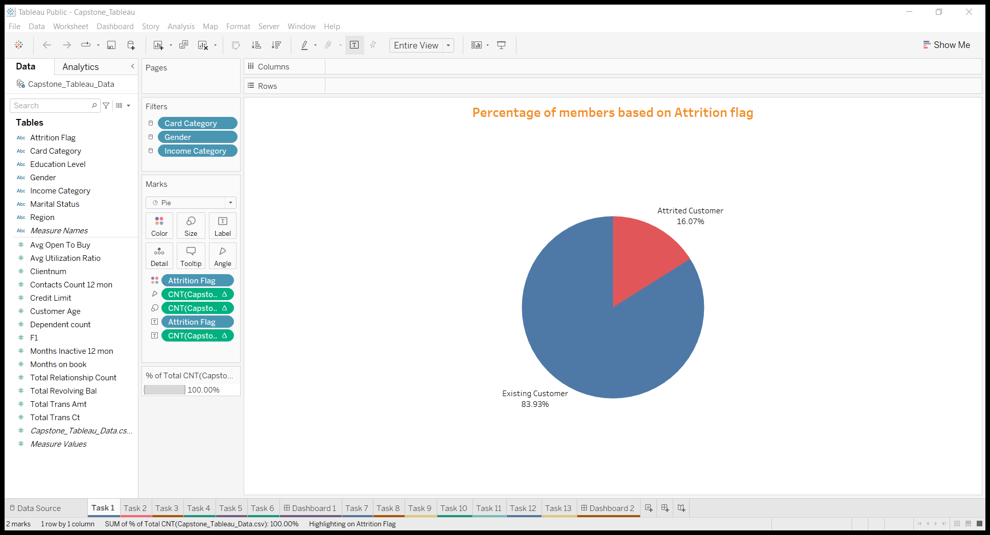
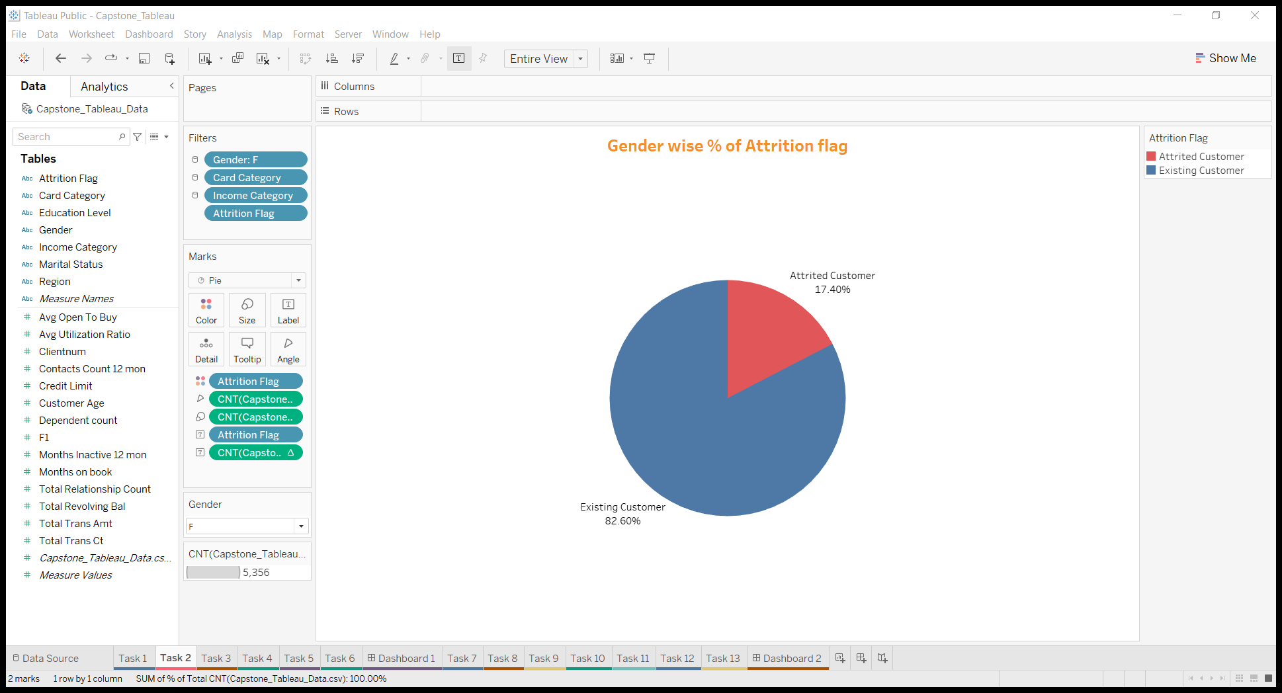
Task 1
Display the percentage of attrited and existing customers from the data
Task 2
Display gender-wise percentage of attrited and existing customers from the data
There are 84% of Existing customers and 16% of attrited customers .
By this most of the customers are females and have higher chance of attrition

Slide 9
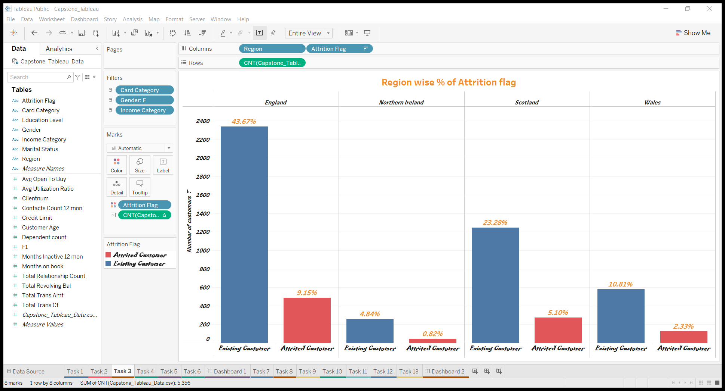
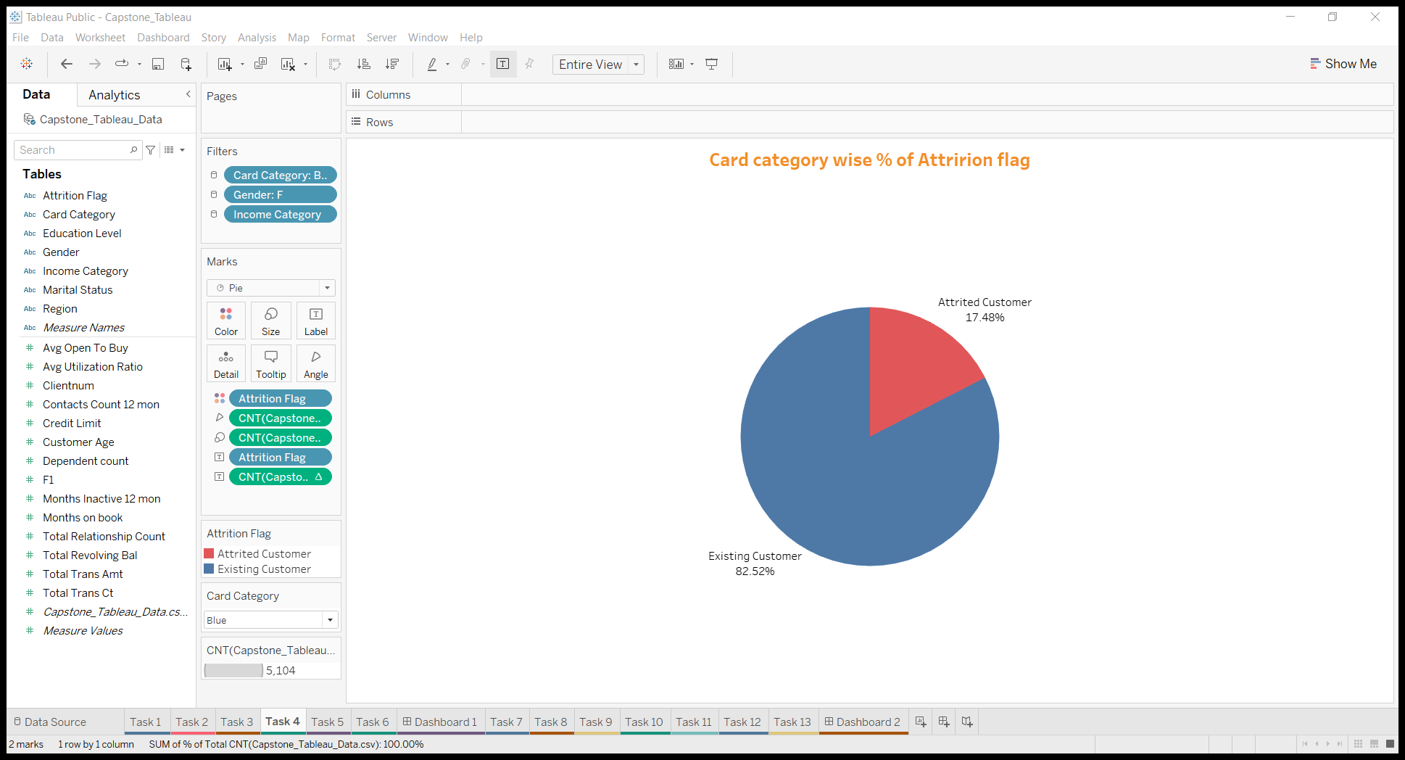
Task 3
Task 4
Display region-wise percentage of attrited and existing customers from the data
Display the percentage of attrited and existing customers for each card category
It is found that blue card is the most preferable card among most of the people
It is found that England has the highest attrition rate among all regions

Slide 10
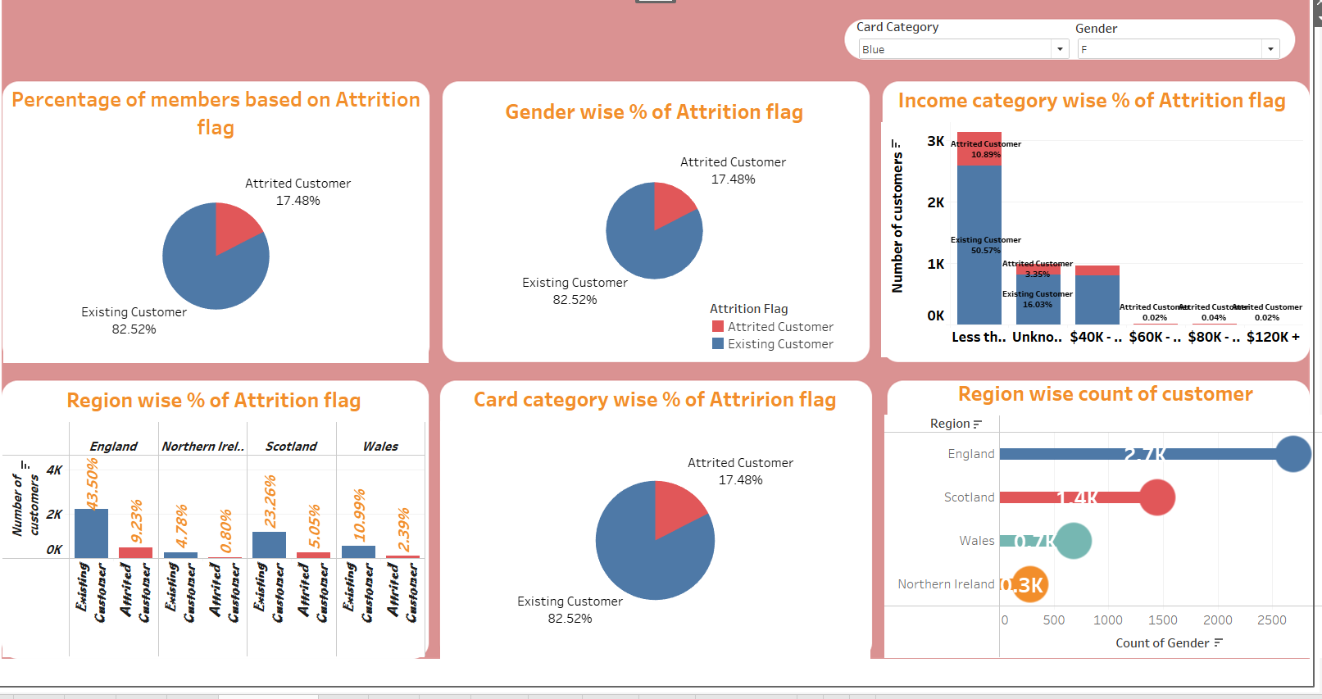
Dashboard
Link
Dashboard

Slide 11
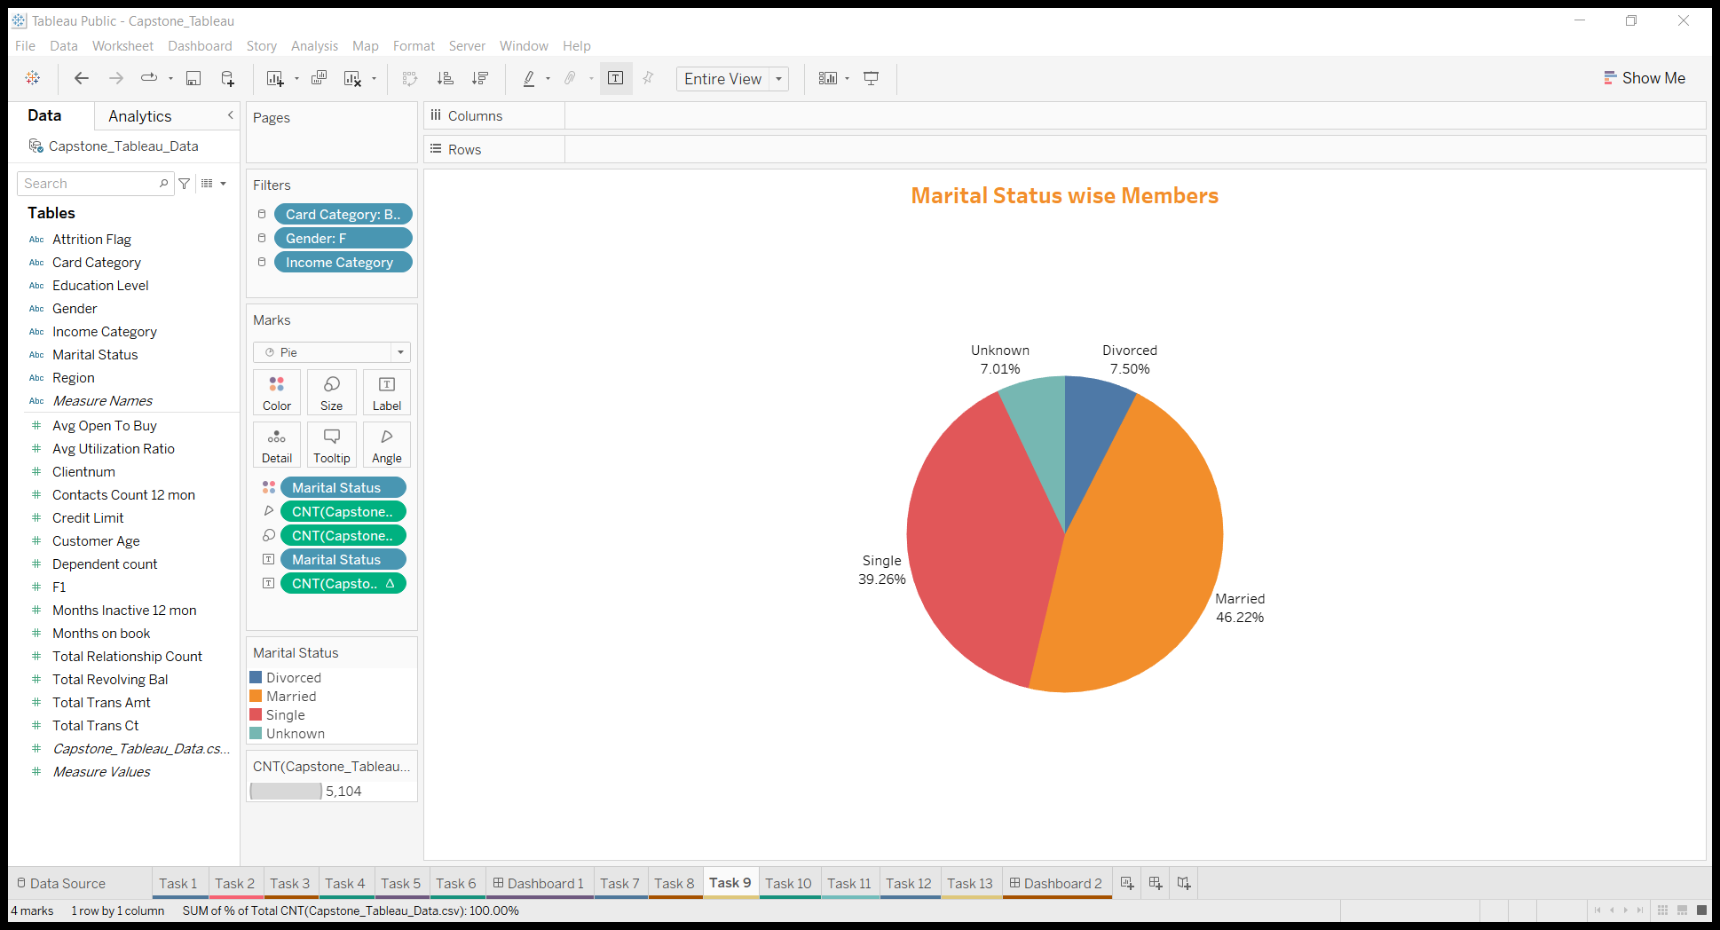
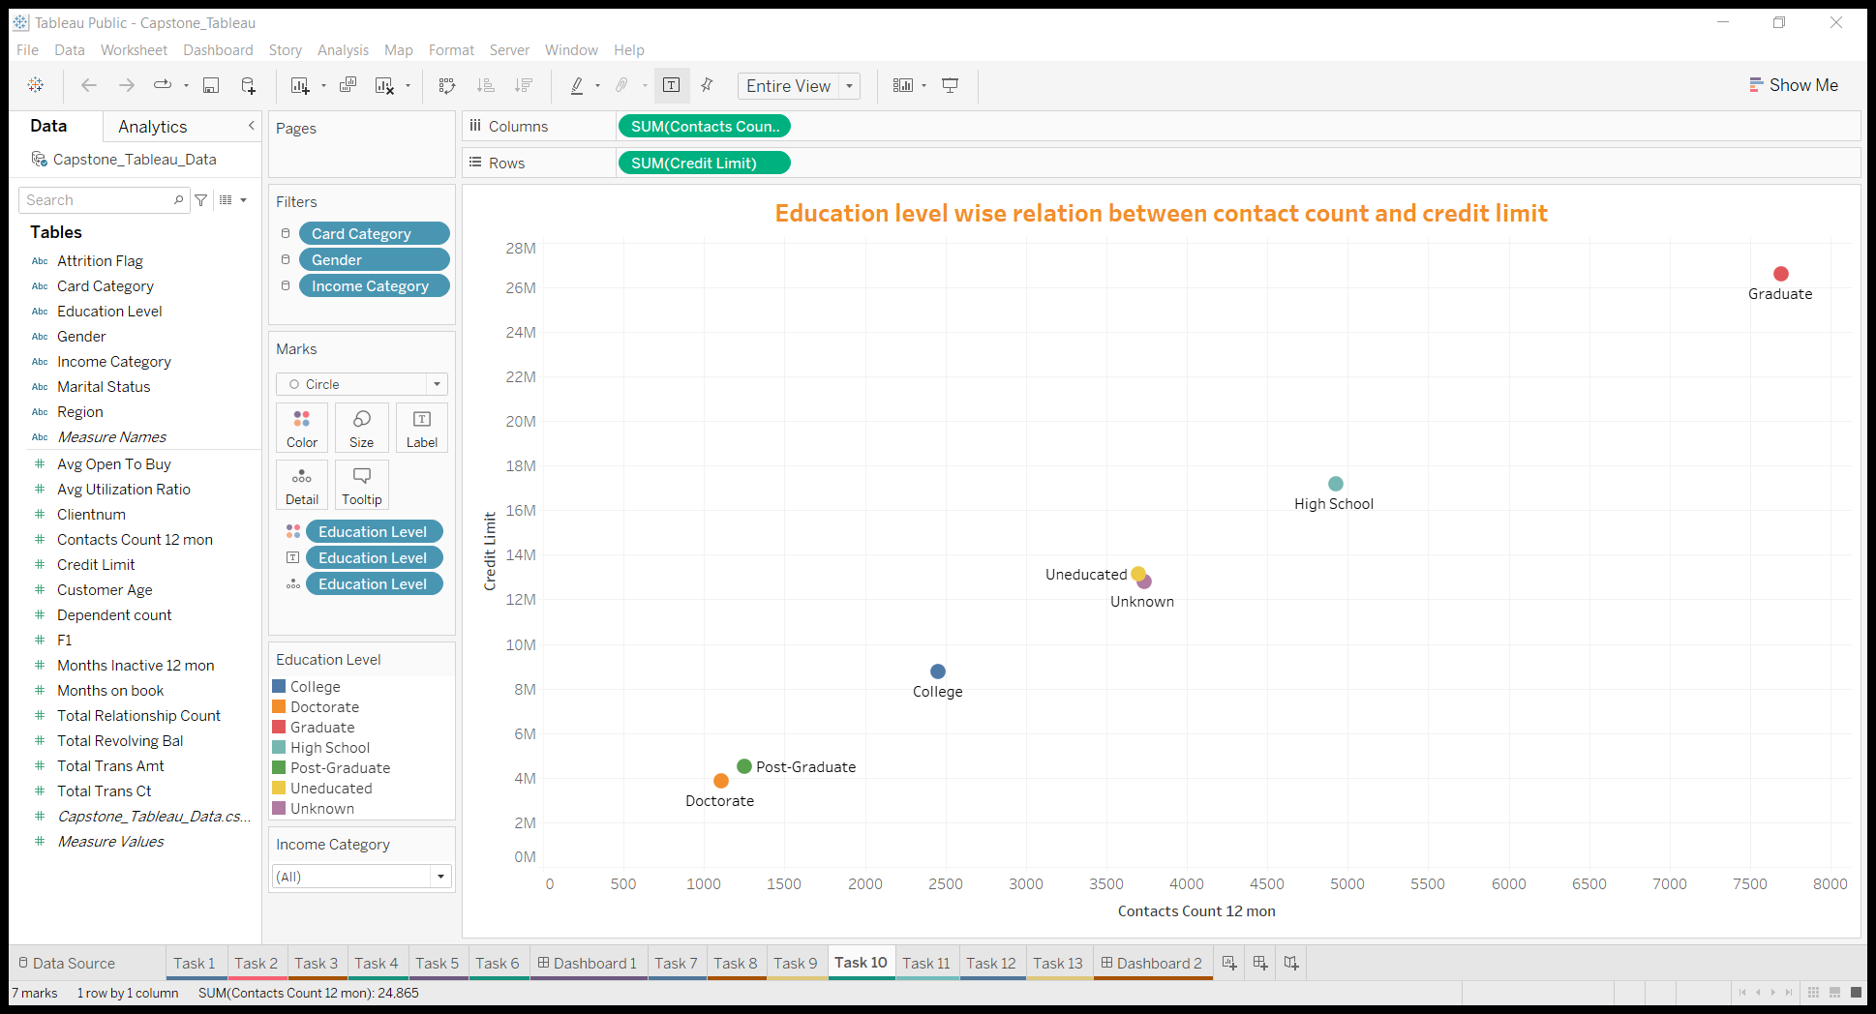
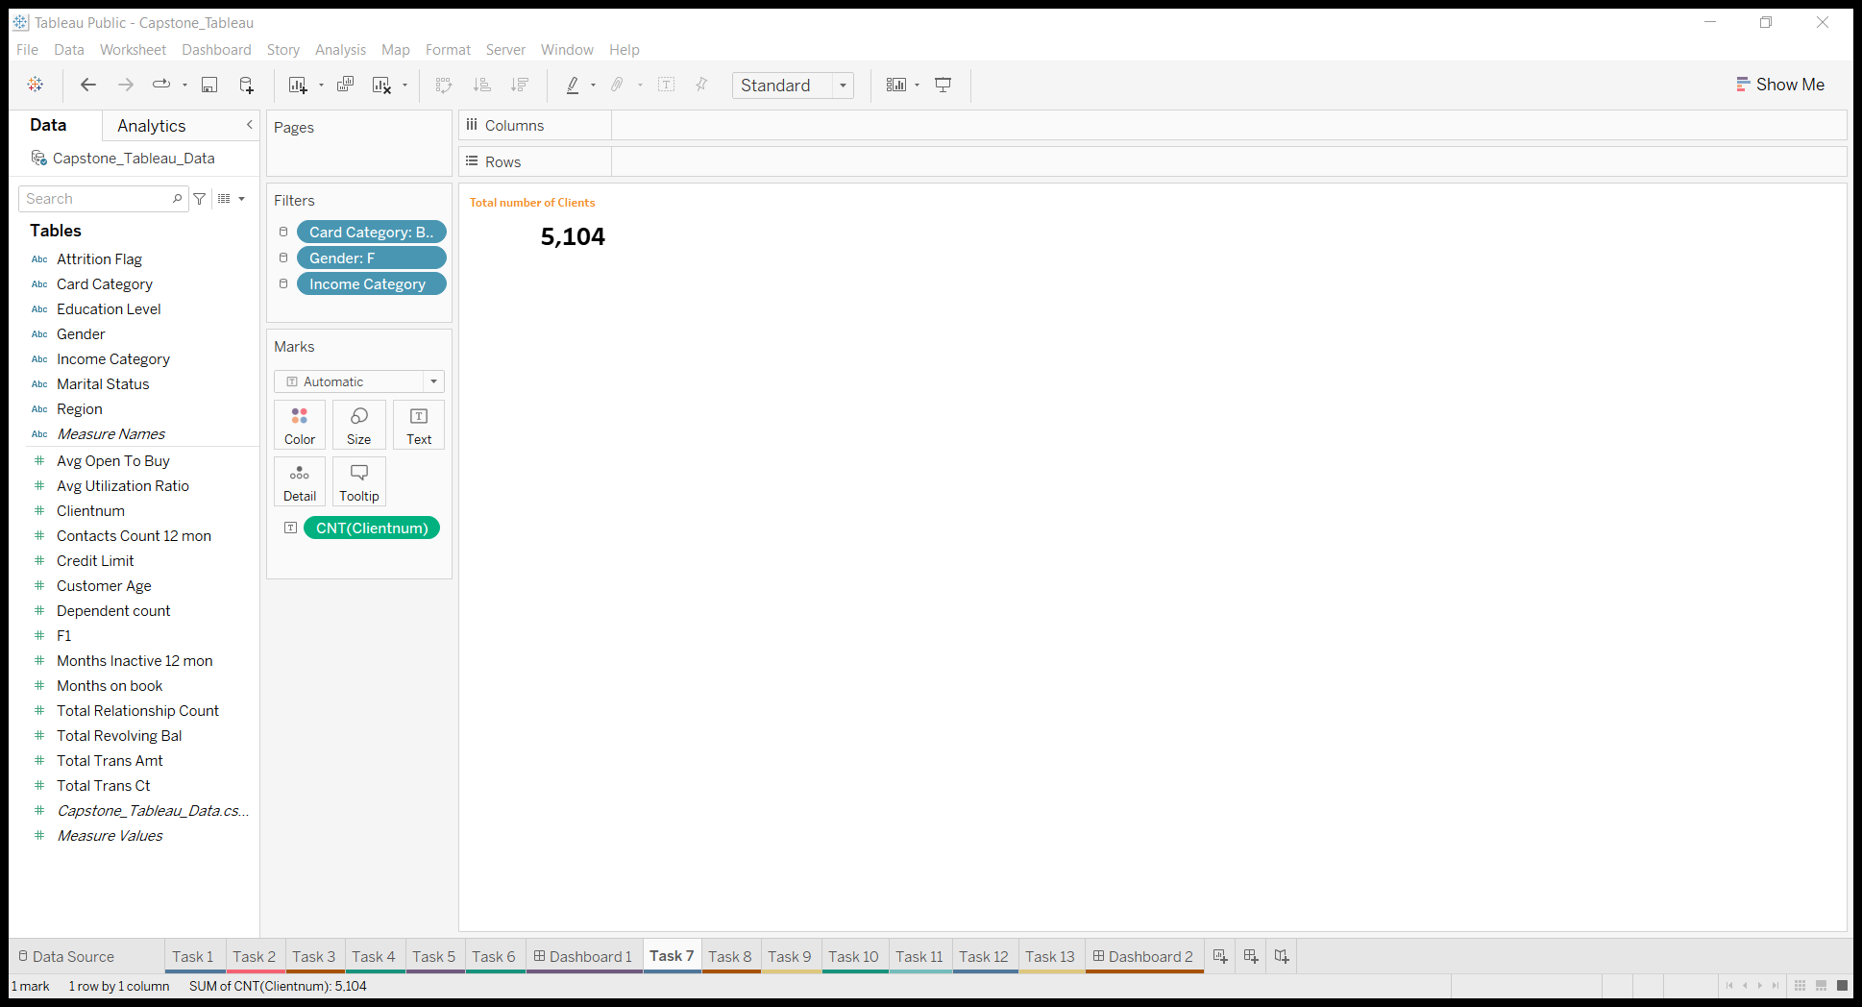
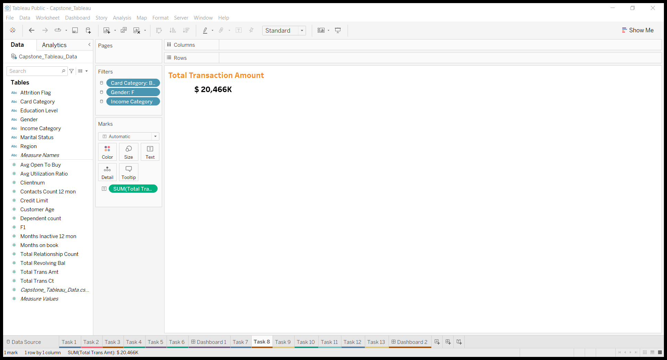
Some Additional analysis
More numbers of members are Married
Education level wise relation Contact and credit limit is positively correlated

Slide 12
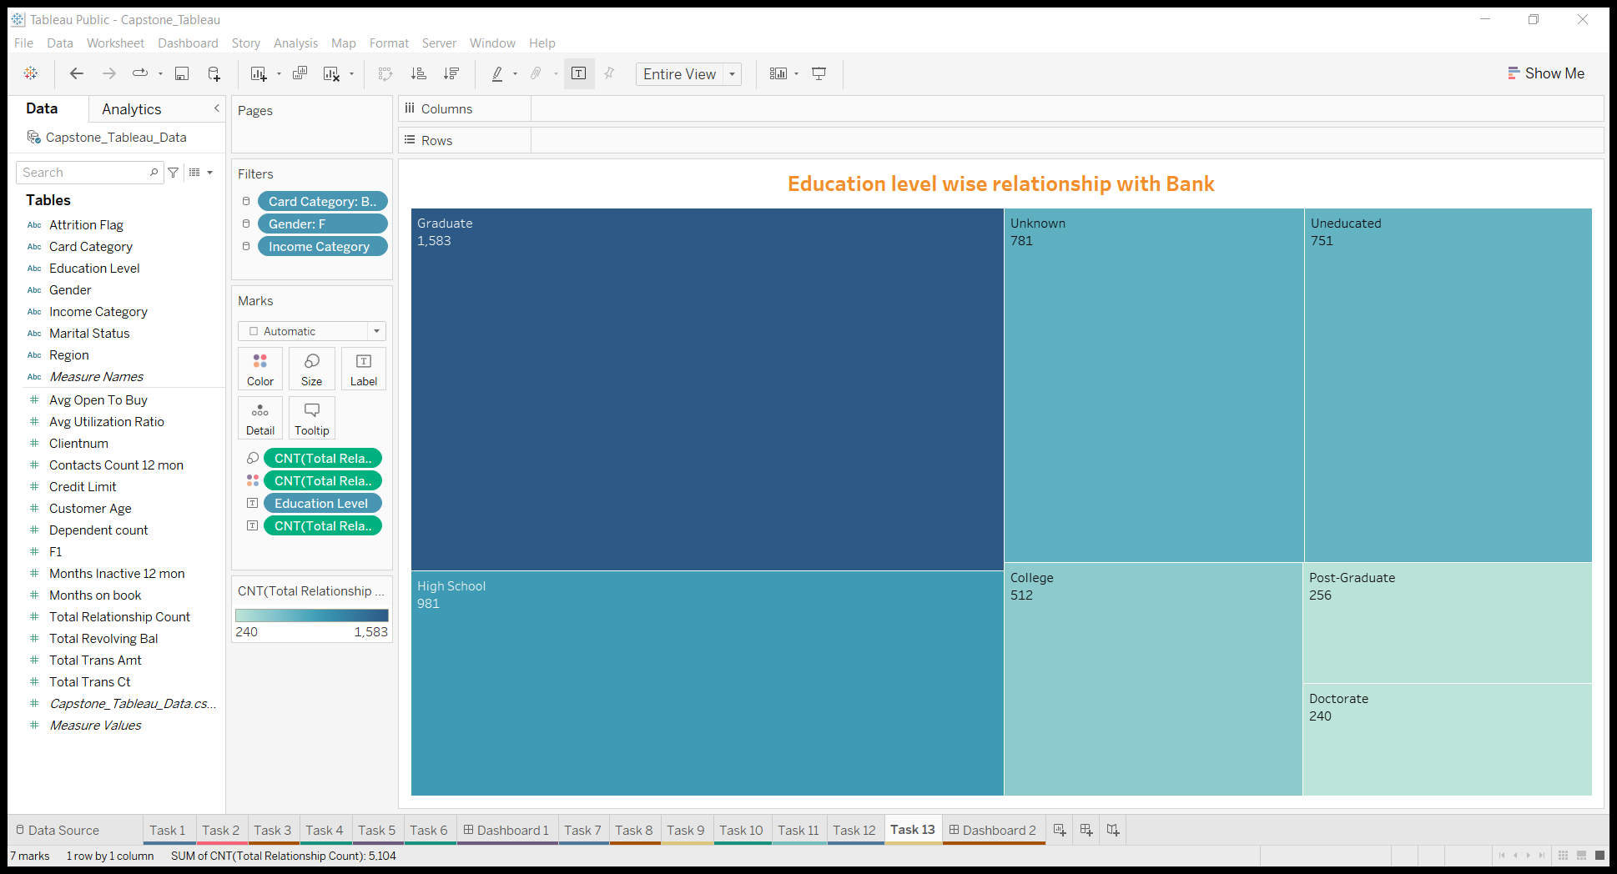
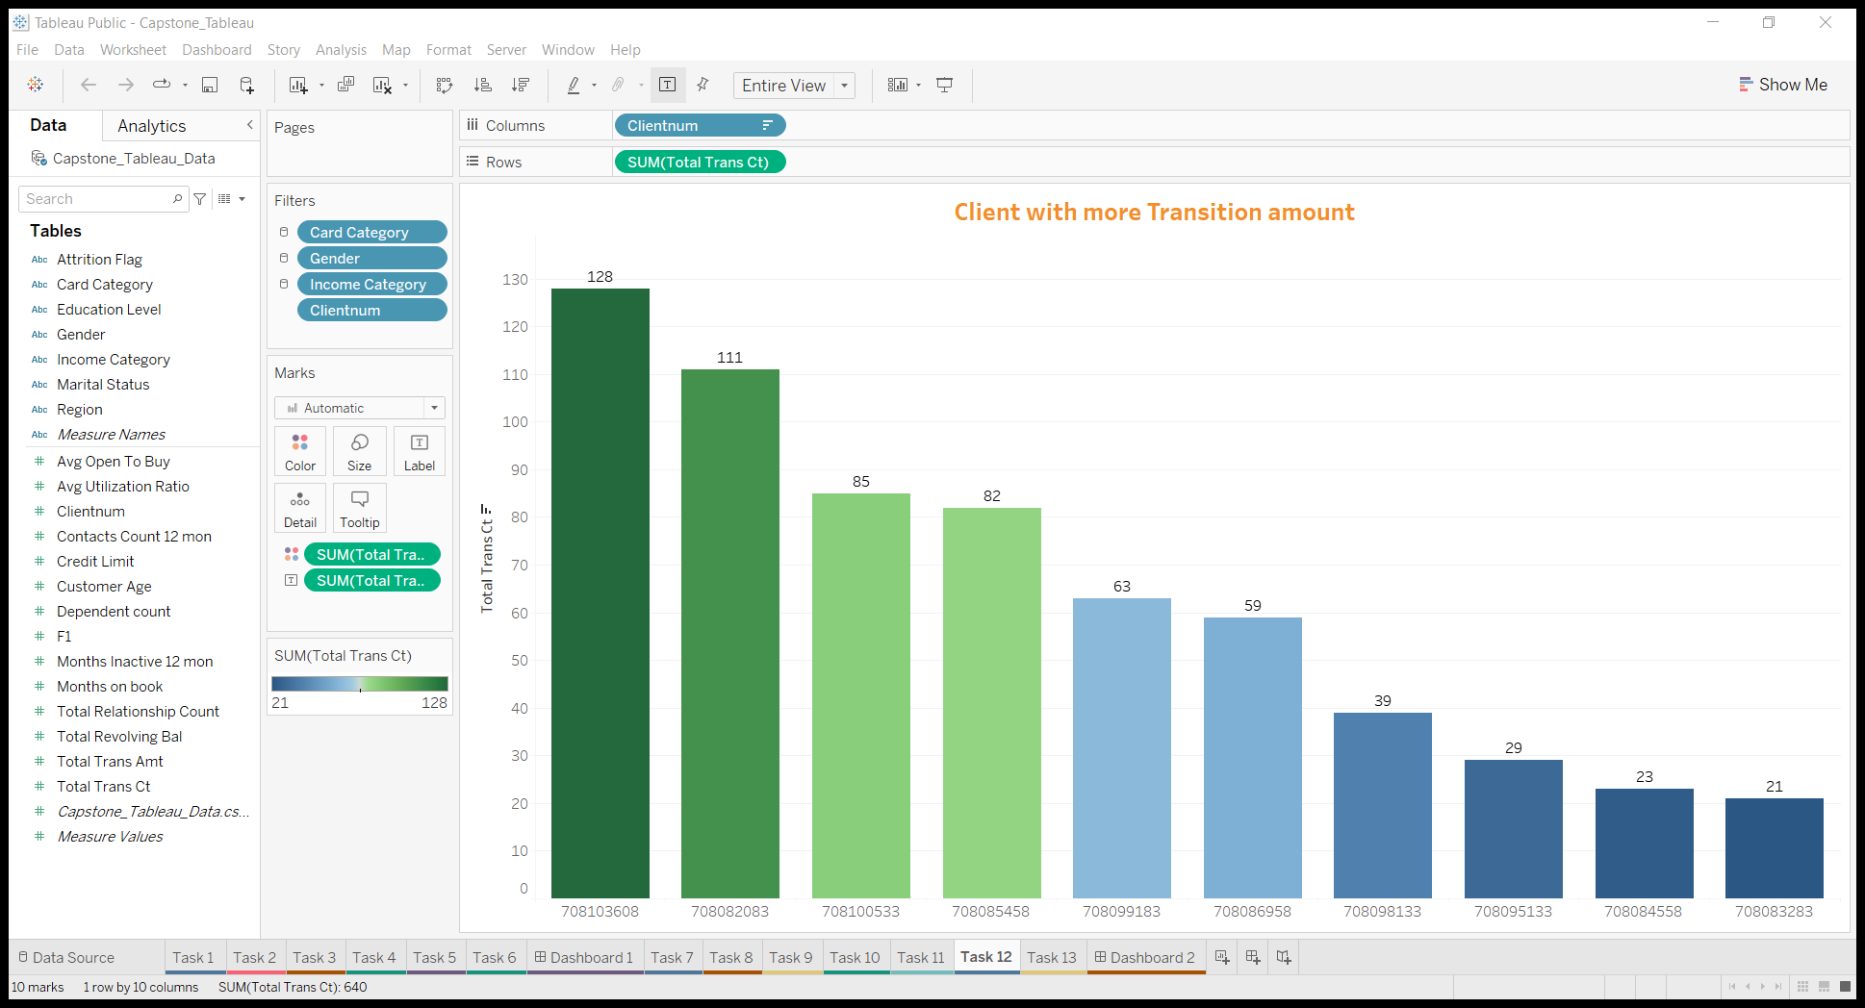
It is found that graduate have more relationship count than other Education level of about 1,583
It is found that the client 708082083 have highest transition count of about 111

Slide 13
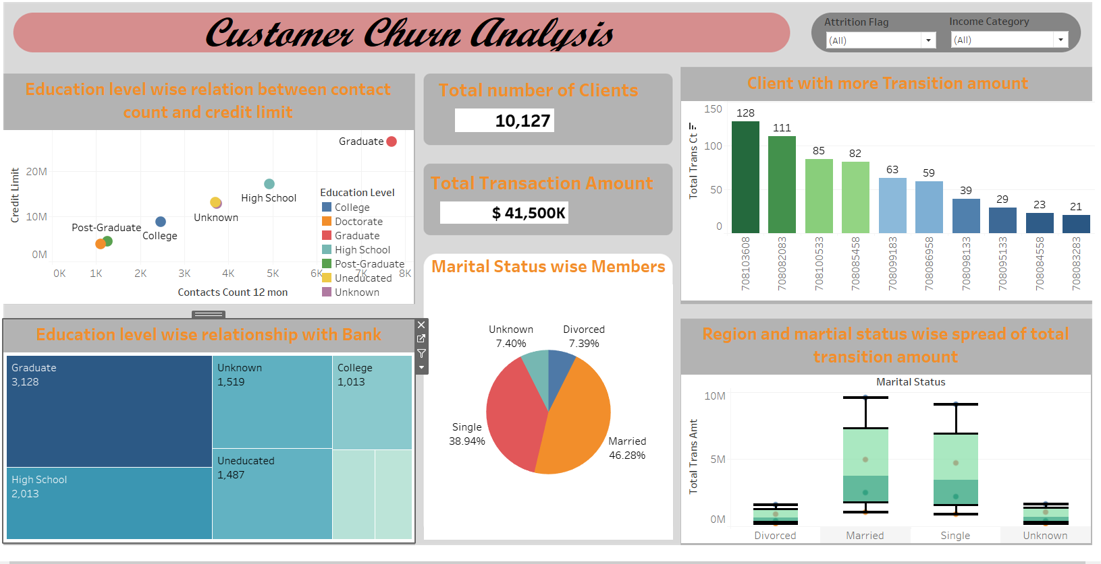
Dashboard
Link for Dashboard

Slide 14
Summary
Only 16% customers are attrited from the bank as per the dataset.
Chances of females for attrition is higher than males.
Attrition is high for lower income
Customers form England uses the credit card more than other region
90% of customers preferred blue credit cards.
Customers with less dependencies have less chances of attrition.
It is found that graduate have more relationship count with bank.

Slide 15
Thank you

